Slide 1
Credit Card FINANCIAL ANALYSIS REPORT
By khushi kumari

Slide 2
CONTENT
D
OBJECTIVE
Goals set for the project.
A
DATA ANALYSIS
Techniques for preparing the data for analysis.
T
INSIGHTS
Key findings and outcomes.
A
DASHBOARD
Project dashboard in pdf

Slide 3
INTRODUCTION
This project provides a detailed examination of credit card operations, focusing on key performance metrics and trends. By using advanced data analytics and visualization tools, we aim to offer stakeholders valuable insights for strategic decision-making and improved operational efficiency.
This report explores patterns in transaction volumes, revenue generation, and customer behavior, helping to identify crucial insights that can guide future strategies. Our goal is to enable stakeholders to monitor and optimize credit card operations effectively, ensuring sustained growth and better financial performance.

Slide 4
OBJECTIVE
Primary Goal: Develop a dynamic, real-time Power BI dashboard to analyze credit card operations.
To create a comprehensive weekly dashboard that offers real-time insights into key performance metrics and trends, allowing stakeholders to effectively monitor and analyze credit card operations.

Slide 5
DATA ANALYSIS
DATA LOADING
Gather all necessary data to form the foundation for analysis.
DATA CLEANING
Ensure data accuracy and consistency.
DATA TRANSFORMING
Used DAX (Data Analysis Expressions) and Power Query for data manipulation.
DATA
VISUALIZATION
Utilized charts, graphs, and tables to represent key metrics.

Slide 6
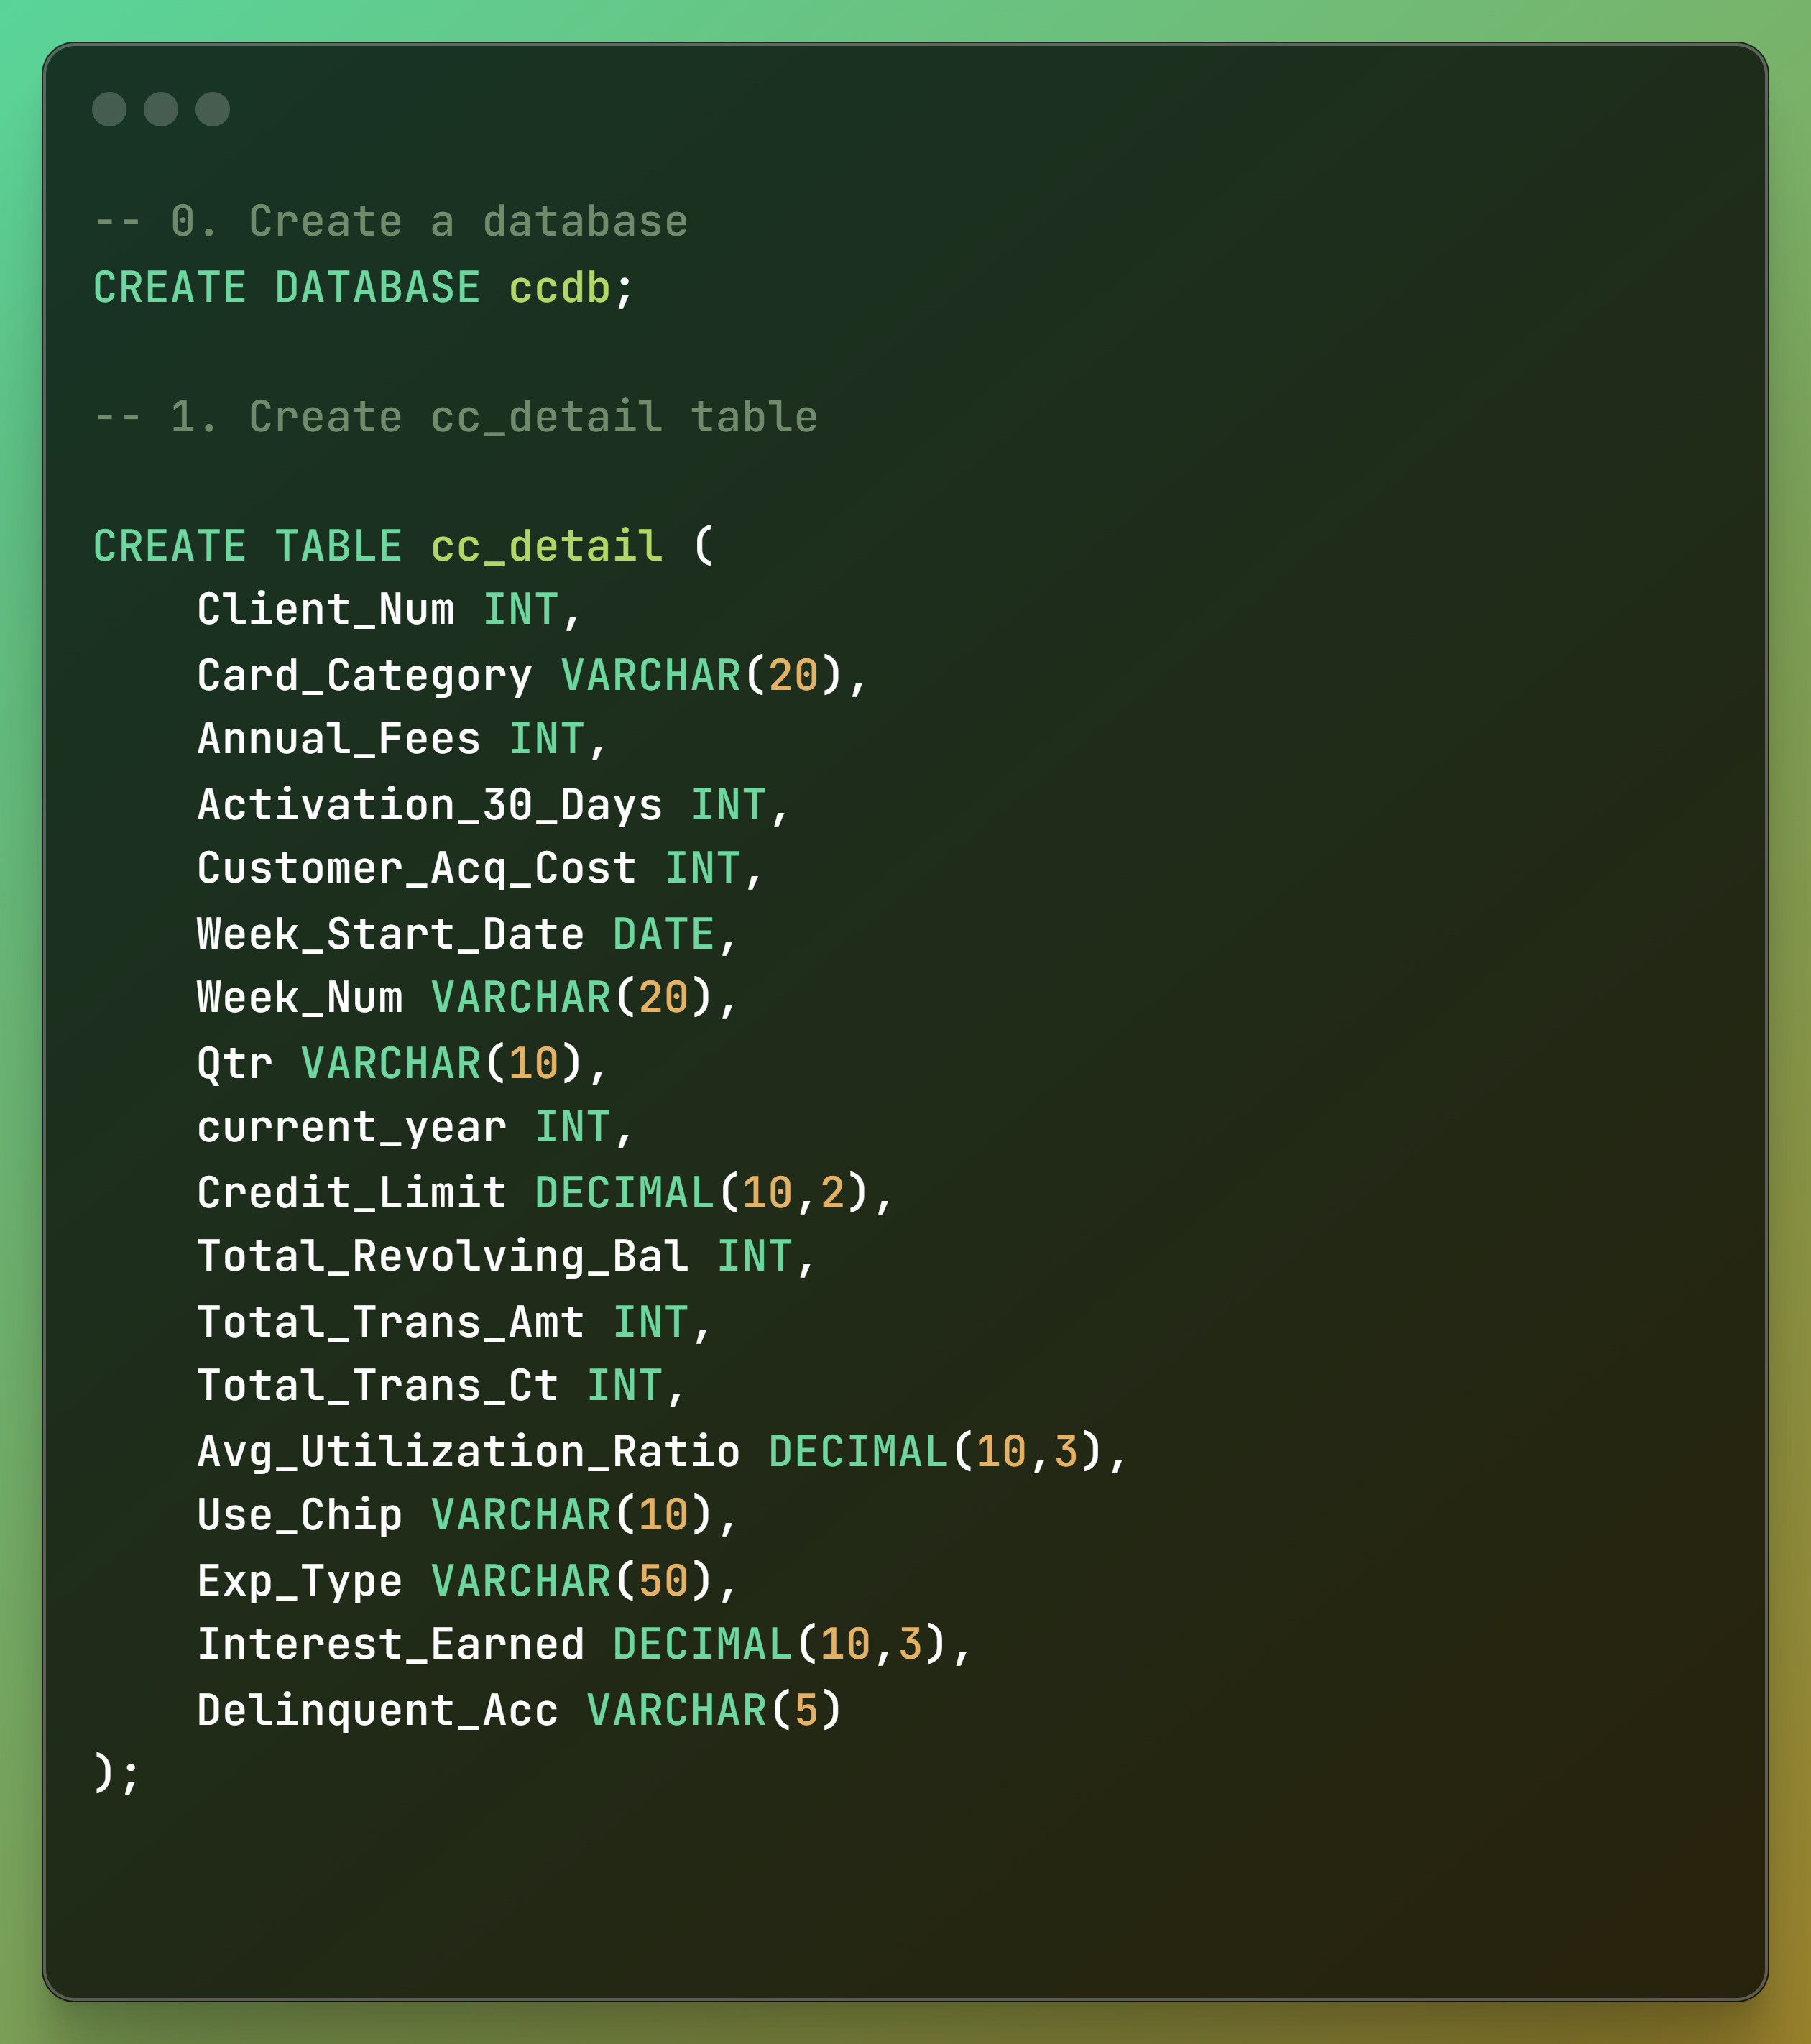
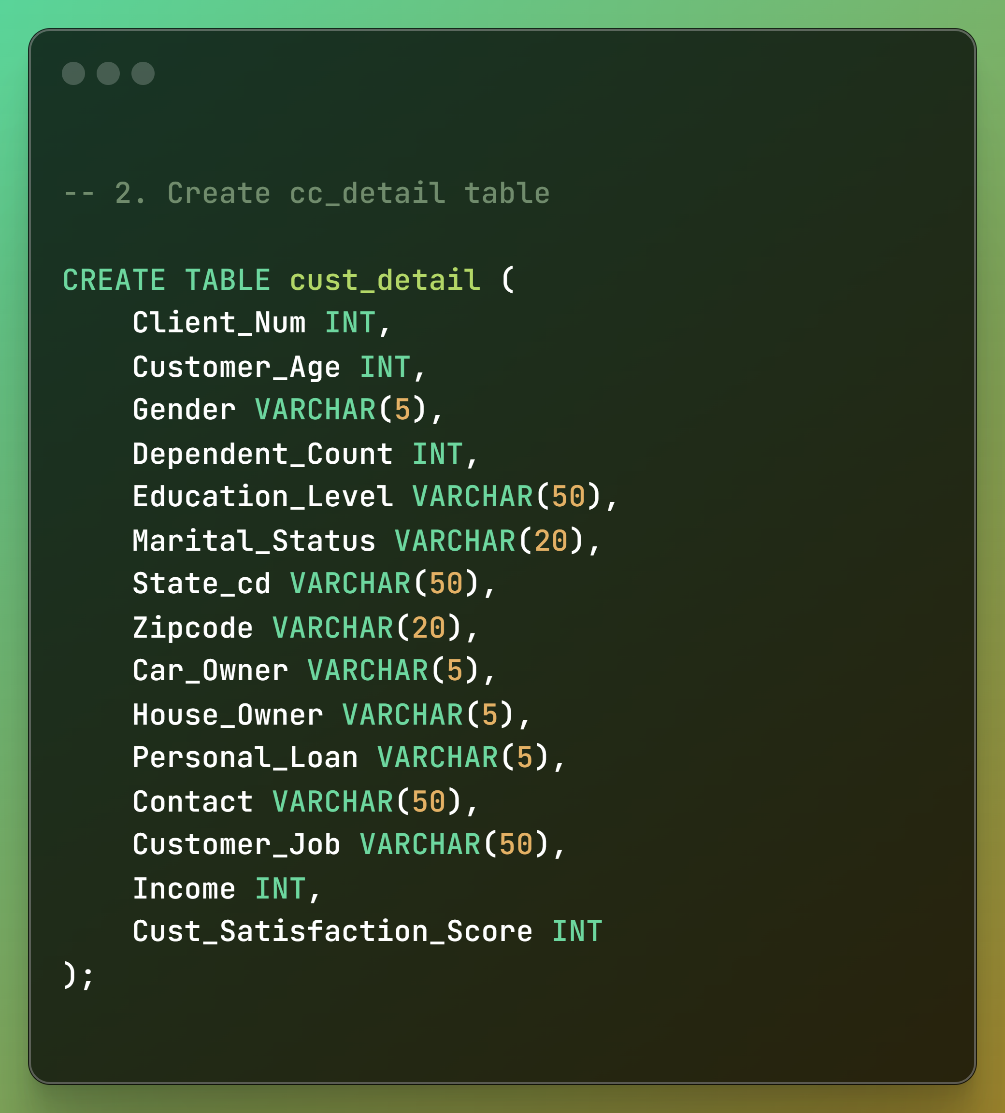
CREATING TABLES

Slide 7
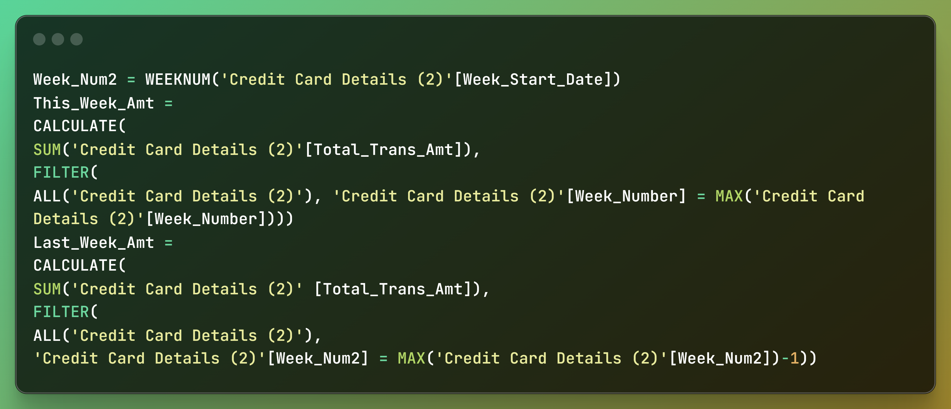
DAX QUERIES

Slide 8
PROJECT INSIGHTS
Revenue surged by 28.8% WoW.
Total Transaction Amt & Count increased (exact percentages TBD).
Customer count also saw growth (exact percentage TBD).
YTD revenue hit $55M; interest earned is $8M.
Total transaction amount reached $46M.
Male customers contributed $30M, females $25M.
Blue & Silver credit cards dominated with 93% transaction share.
TX, NY & CA contributed 68% of revenue.
Activation rate stands at 57.5%.
Delinquency rate is 6.06%, highlighting financial health and growth potential.

Slide 9
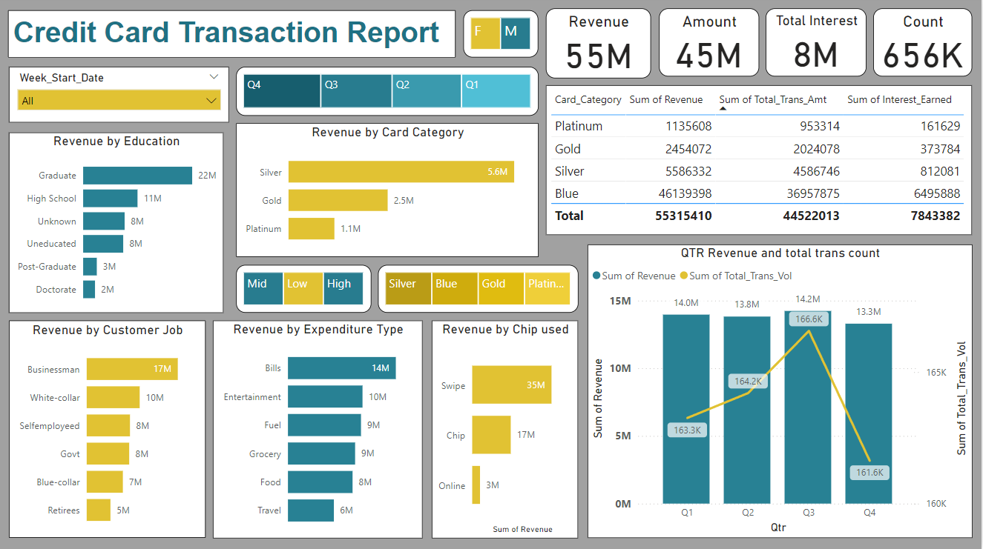
DASHBOARD

Slide 10
THANK YOU

